Slide 1


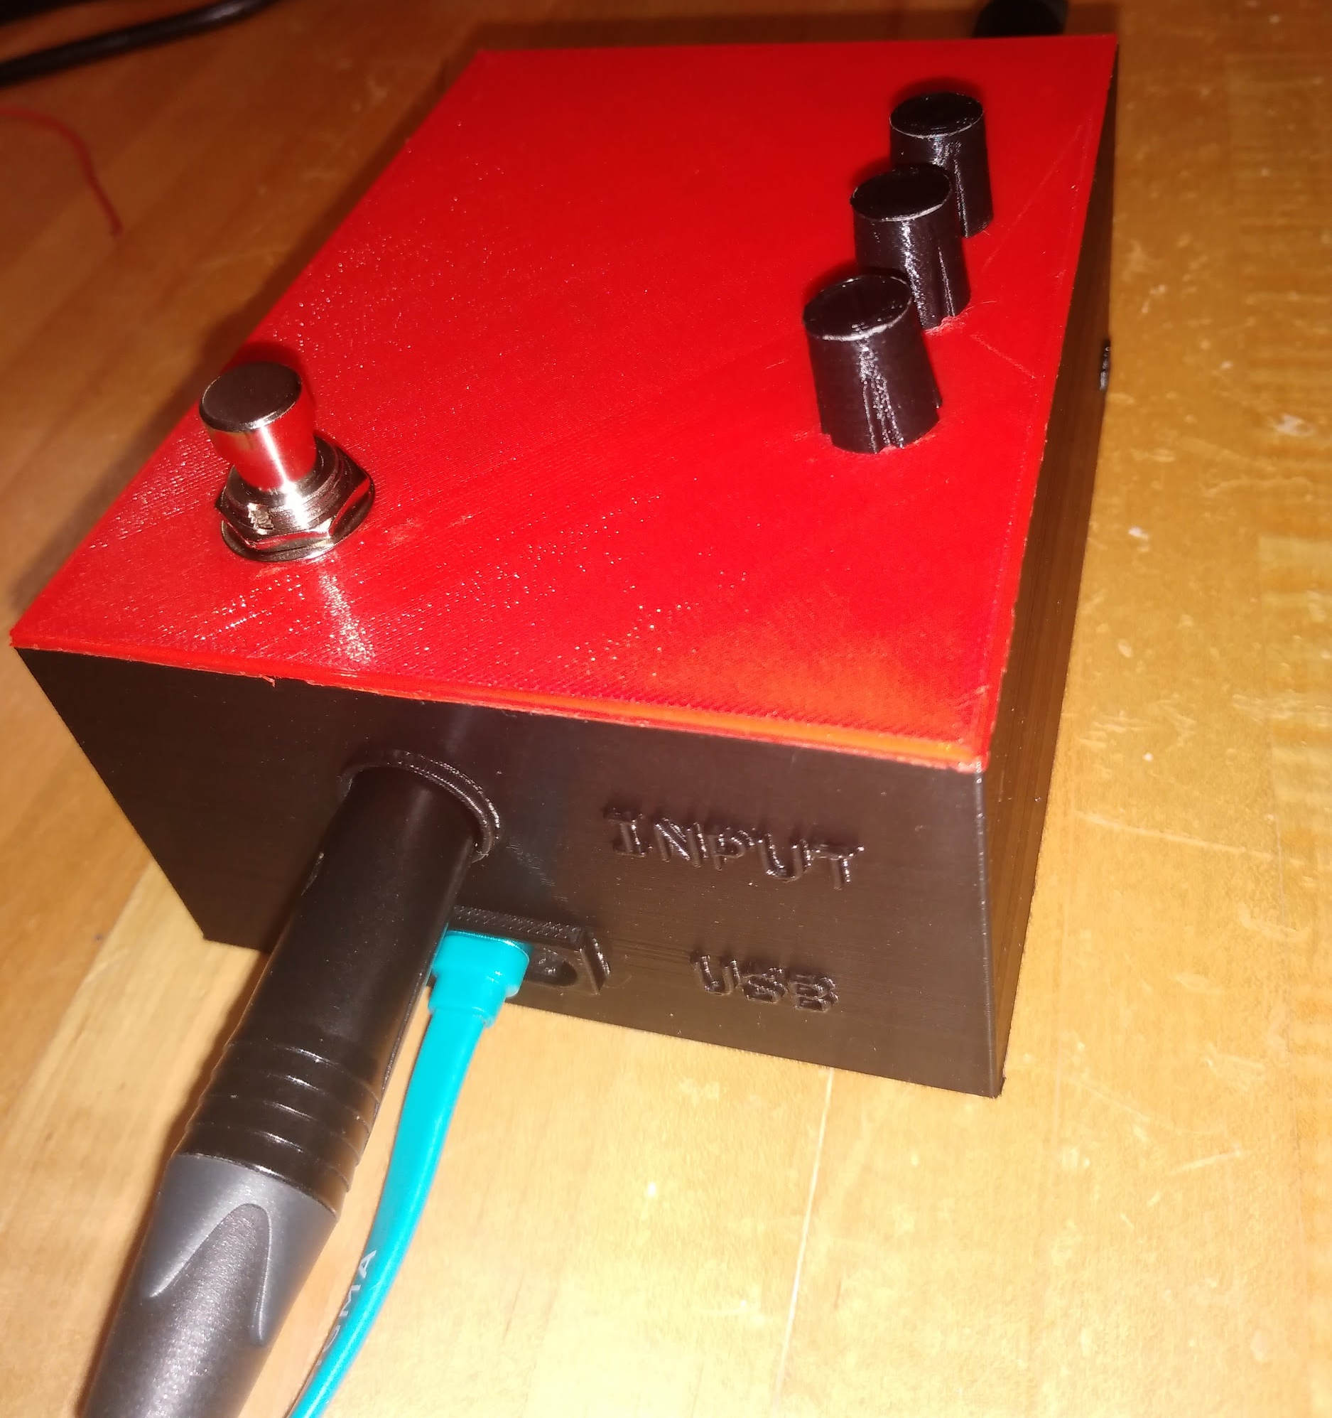
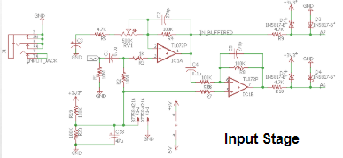
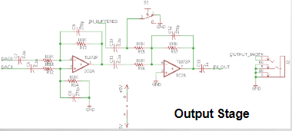
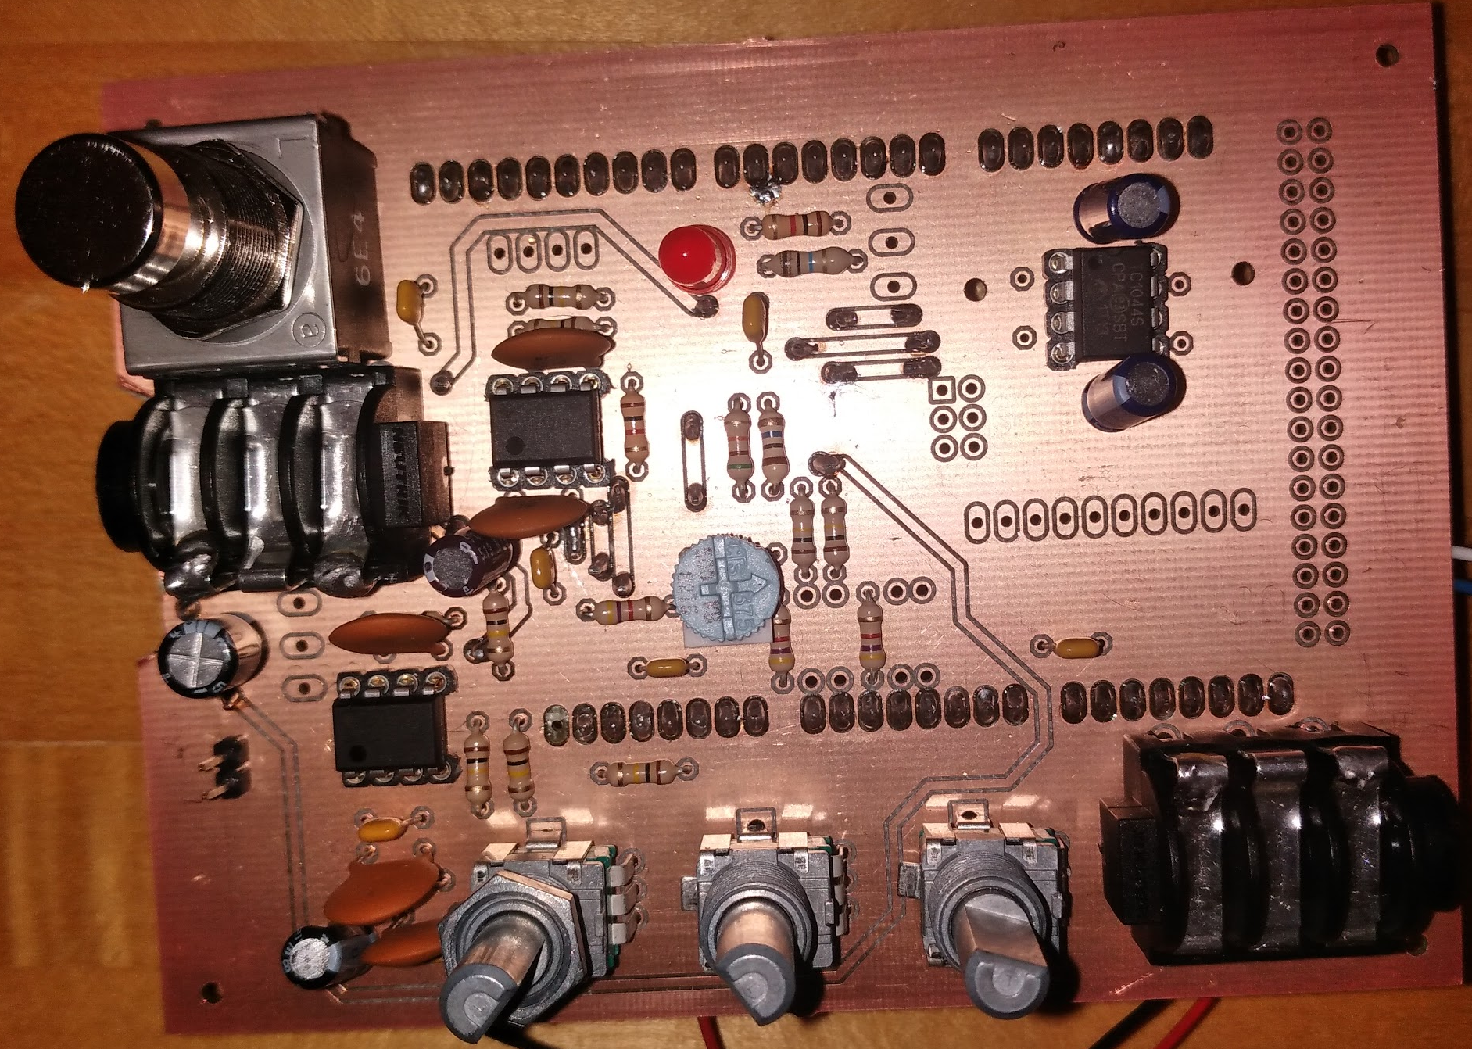
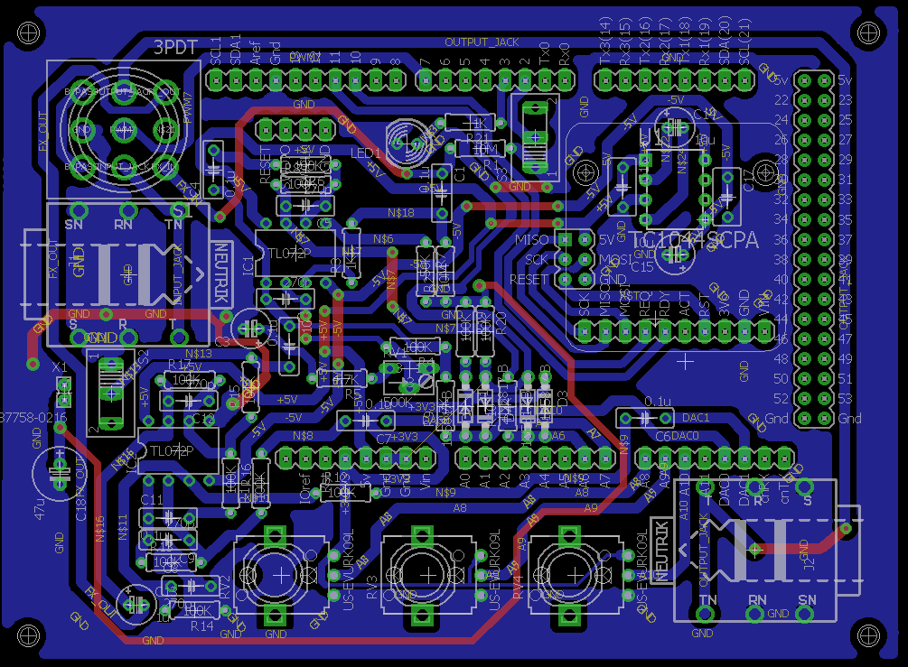
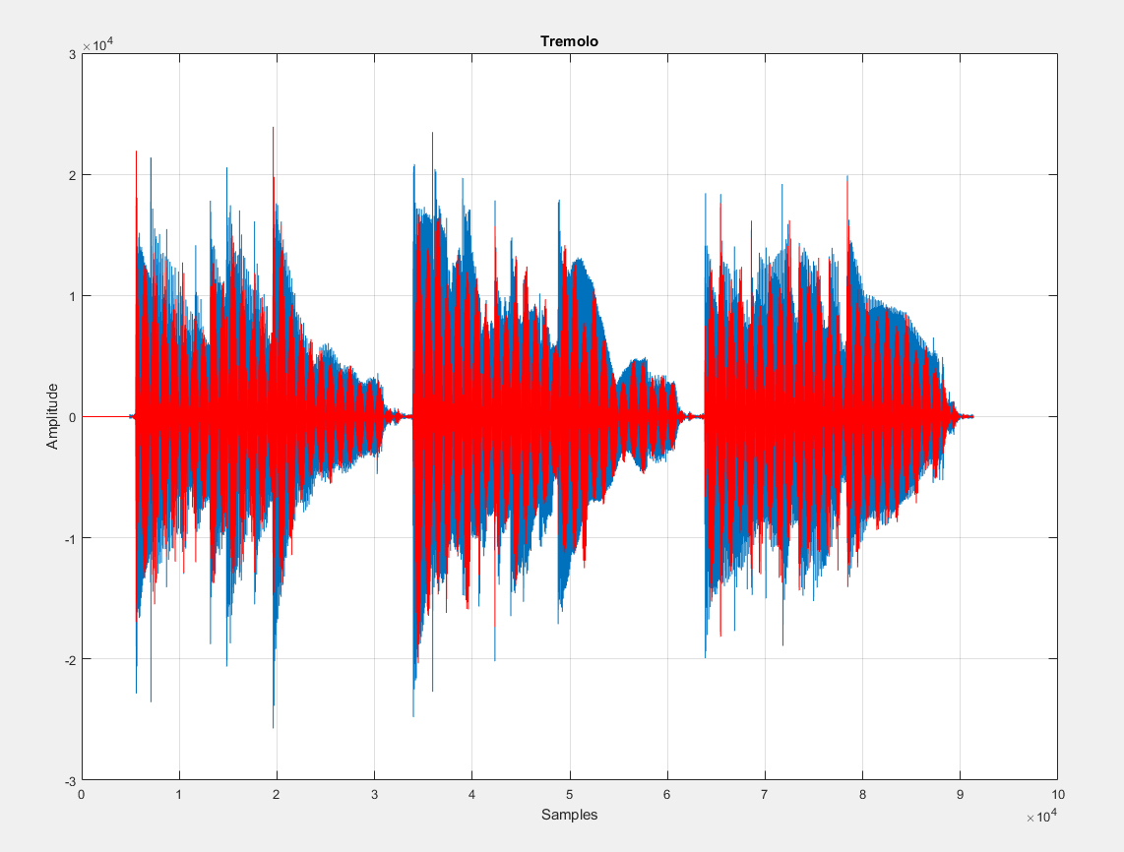
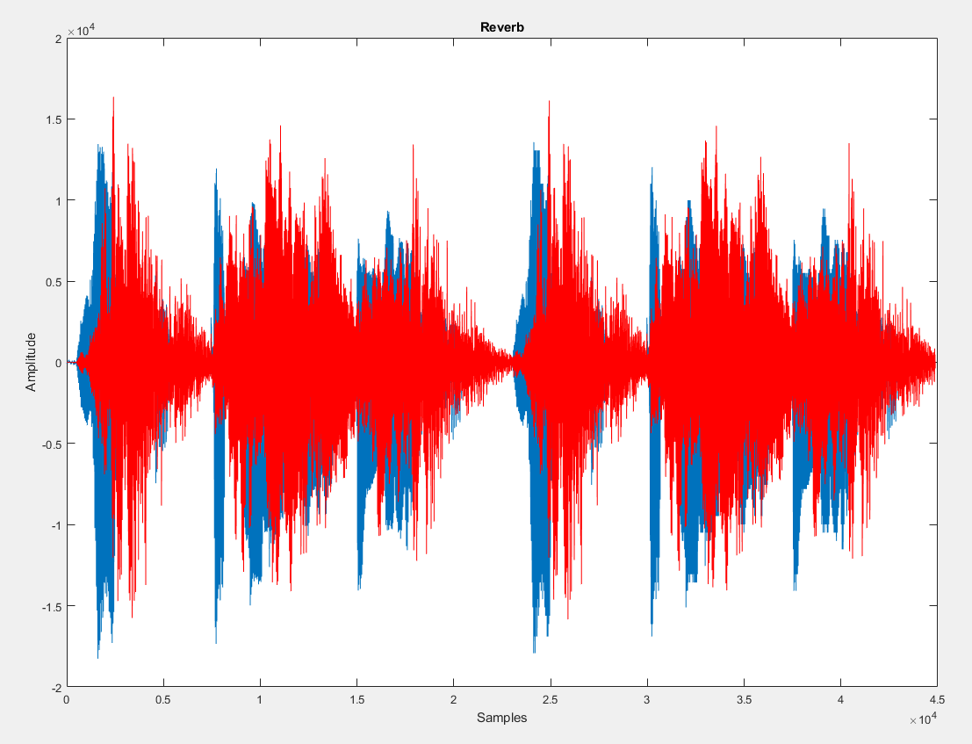
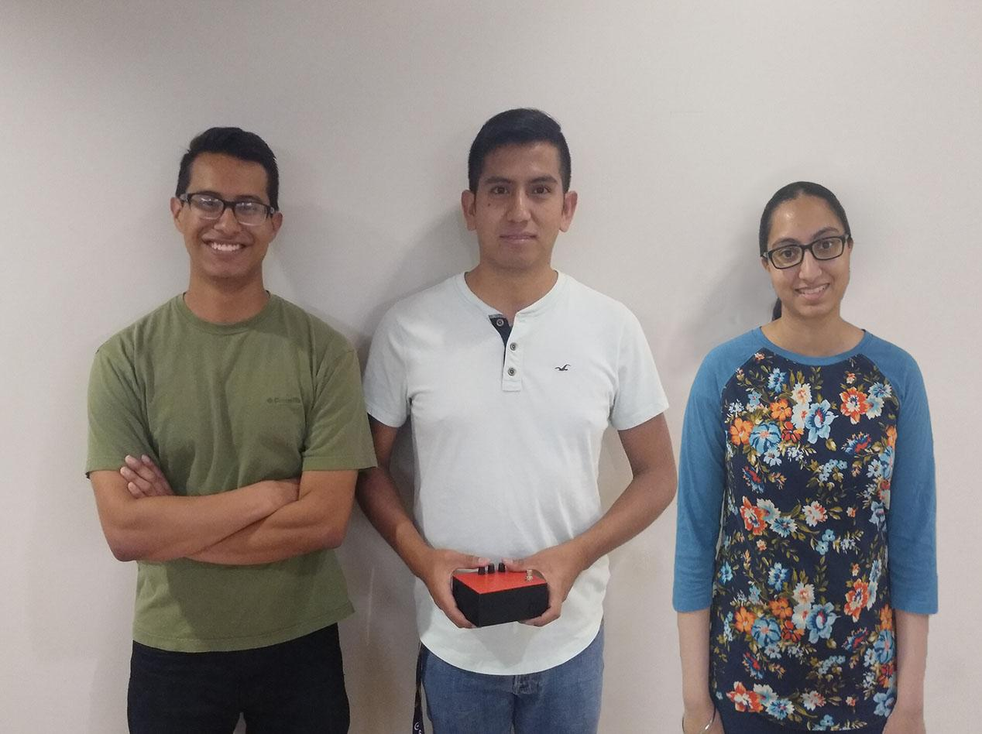

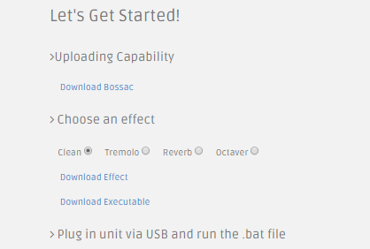
Computer Systems Design Laboratory
University of Kansas
Modifiable Guitar Effects Unit
By: Sam Lopez, Luis Chachayma, Jaspreet Kaur
PROJECT OVERVIEW
Writing music is frustrating at times. Effect pedals help to spur creativity, but they are expensive. Also, the effect(s) available on a unit cannot be changed, prompting more purchases. This economic cost eventually dissuades novices or hobbyists from writing music.
This project introduces a reprogrammable, multi-effect guitar signal processing unit at a low cost.
HARDWARE DESIGN
Signal from a guitar is amplified in a non-inverting/inverting op amp network, and sent to different ADCs on the Arduino. Potentiometers are used to adjust gain, and are referenced in the code for the modulation of volume and the effect depth. A footswitch is used to toggle on/off an effect. The original and processed signals generated at the DACs are read in parallel and added, for faster real time output of effects like delay. The output is amplified for connection to a guitar amp.
IMPLEMENTATION
Public website for uploading a different effect to Arduino DUE
Android app for switching between loaded effects via BlueTooth
Signal processing in C on Arduino platform, MATLAB inspired
PCB designed with Eagle
Enclosure 3D printed with CAD
SOFTWARE DESIGN
Reverb, Tremolo, and Octaver effects were programmed in C for the Arduino, modeled after MATLAB code. For example, Reverb simulates the sound that results from reflections bouncing off surrounding walls. This effect can be programmed by delaying two signals at different times and generating them at the DACs. The website is hosted on the EECS server, using a batch file to upload the downloadable binary file of an effect to the Arduino, making it easy for any user. The app sends a character to the unit, which is read by a HC-05 BlueTooth module and switches to the effect corresponding to it in real time.
Notes:
1

